Slide 1
Job Market Analysis
Data-Driven insights into job Trends and Salaries
Name: Ayushman Dutta
Name: Jayavelu D

Slide 2
Introduction to Job Market Analysis
Job market analysis involves examining employment trends, salary distributions, and skill demands across industries and locations. In today’s data-driven world, such analysis helps job seekers, employers, and policymakers make informed decisions.
This project leverages data analytics tools to uncover meaningful insights from job listings, focusing on salary patterns, hiring trends, and skill requirements.

Slide 3
Problem Statement
The job market is highly dynamic, with varying salary structures, skill demands, and hiring trends across regions and industries. However, raw job data is often unstructured and difficult to interpret.
This project aims to transform raw job listing data into meaningful insights that can help understand:
Which skills are in demand
Which locations offer better opportunities
How salaries vary across roles and education levels

Slide 4
Objectives
The primary objectives of this project are:
To analyze job distribution across different states
To study salary trends across job roles and locations
To identify top industries and companies hiring
To evaluate skill demand in the job market
To understand the relationship between education and salary

Slide 5
Data Source & Database Connection
The dataset was sourced from a MySQL database hosted on a remote server.
Database connected using mysql.connector
SQLAlchemy used for efficient data handling
Ensures real-world, structured data access
This approach demonstrates integration between databases and analytics tools.

Slide 6
Data Extraction Process
Data was extracted using SQL queries:
Query used: SELECT * FROM Market
Loaded into Pandas DataFrame for processing
Initial dataset explored for structure and quality
This step ensured that raw data was properly imported for further cleaning and analysis.

Slide 7
Data Cleaning & Preprocessing
Data cleaning was a critical step to ensure accuracy and reliability:
Removed irrelevant column FIELD4
Replaced invalid values (-1, '-1') with NULL
Handled missing values:
Numerical → Median imputation
Categorical → "Unknown"
Standardized column names for consistency
Cleaned company names and text fields
These steps improved data quality and usability.

Slide 8
Feature Engineering
New features were created to enhance analysis:
Salary converted from thousands (K) to actual USD values
Created:
lower_salary
upper_salary
avg_salary
Revenue converted into numeric estimated_revenue
Location split into City and State
These transformations enabled deeper and more meaningful analysis.

Slide 9
Tools & Technologies
Python Libraries:
Pandas (data manipulation)
NumPy (numerical operations)
Matplotlib & Seaborn (visualization)
Database: MySQL
Visualization Tool: Power BI
These tools were used to perform end-to-end data analysis.

Slide 10
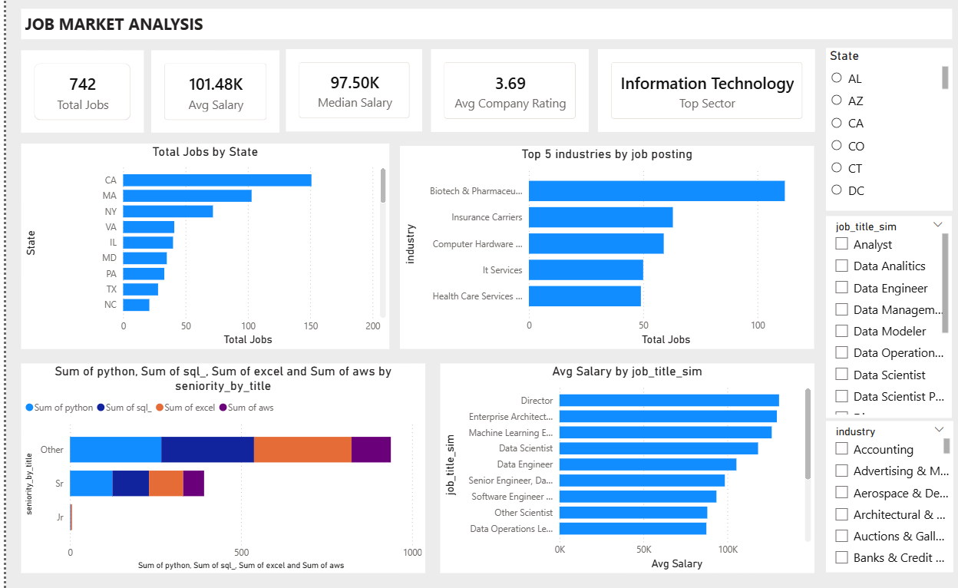
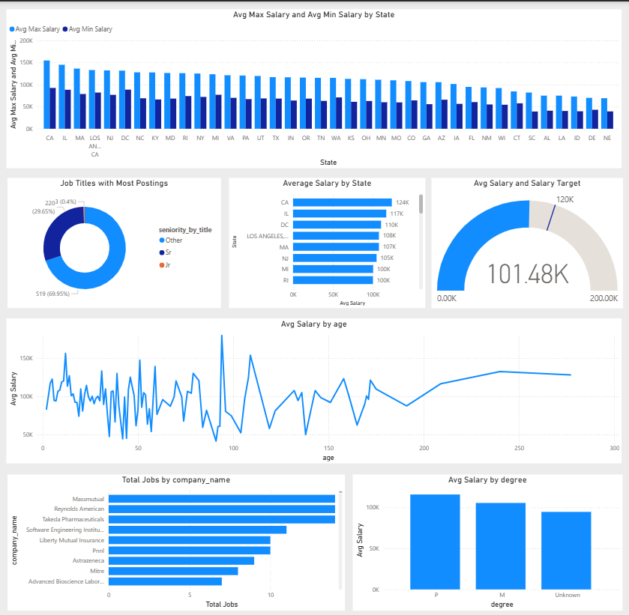
Dashboard Overview (Power BI)
The Power BI dashboard provides an interactive view of job market insights:
State-wise job distribution
Salary trends
Industry demand
Skill requirements

Slide 11
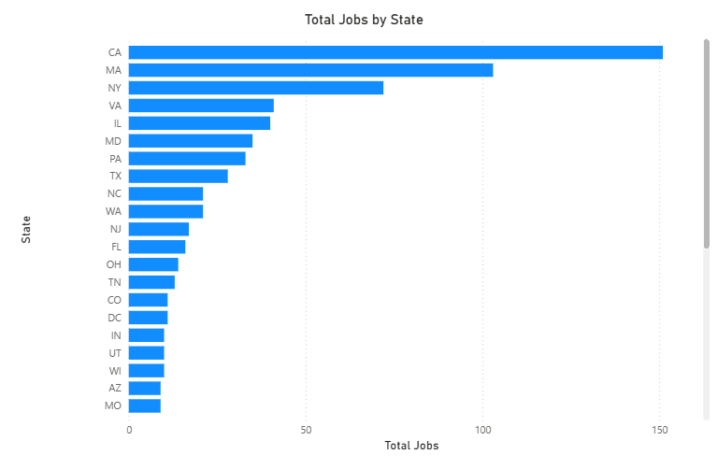
State-wise Job Distribution
The analysis of job postings across states reveals that job opportunities are not evenly distributed. Certain states have significantly higher job postings due to strong industrial presence and economic development. This insight highlights the importance of location in determining job availability.
Key Points:
High concentration of jobs in specific states
Indicates regional economic strength

Slide 12
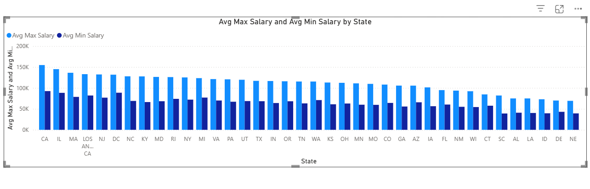
Salary Trends Across States
The salary analysis shows considerable variation across different states. States with advanced industries and higher demand for skilled professionals tend to offer better compensation. This trend reflects the influence of economic factors and industry presence on salary levels.
Key Points:
Significant salary variation across states
Higher salaries in developed regions
Reflects demand for skilled professionals

Slide 13
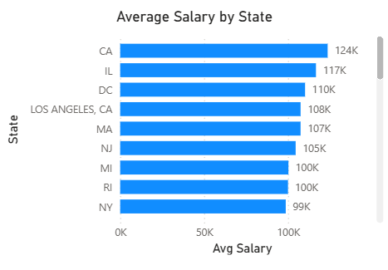
Average Salary by State
The average salary varies across states, showing clear regional differences in pay. Some states offer higher salaries due to stronger industry presence and demand for skilled professionals. This highlights the importance of location in determining compensation.
Key Points:
Salaries differ across states
Higher pay in developed regions
Industry demand affects salary
Location impacts earnings

Slide 14
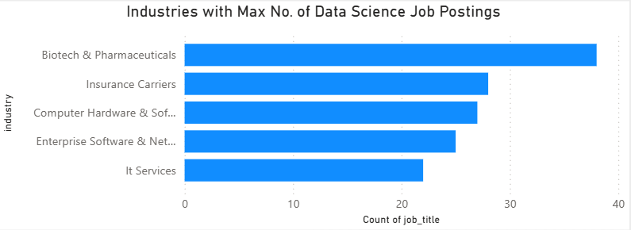
Top Industries 5 Industries for Data Science Roles
The analysis of industries with the highest number of data science job postings highlights where demand for data professionals is most concentrated. A few industries dominate hiring, particularly those driven by technology, data, and digital transformation. This reflects the growing importance of data analytics across multiple sectors.
Key Points:
A few industries account for most job postings
Technology and data-driven sectors lead hiring
Indicates strong demand for data science roles
Helps identify high-opportunity industries

Slide 15
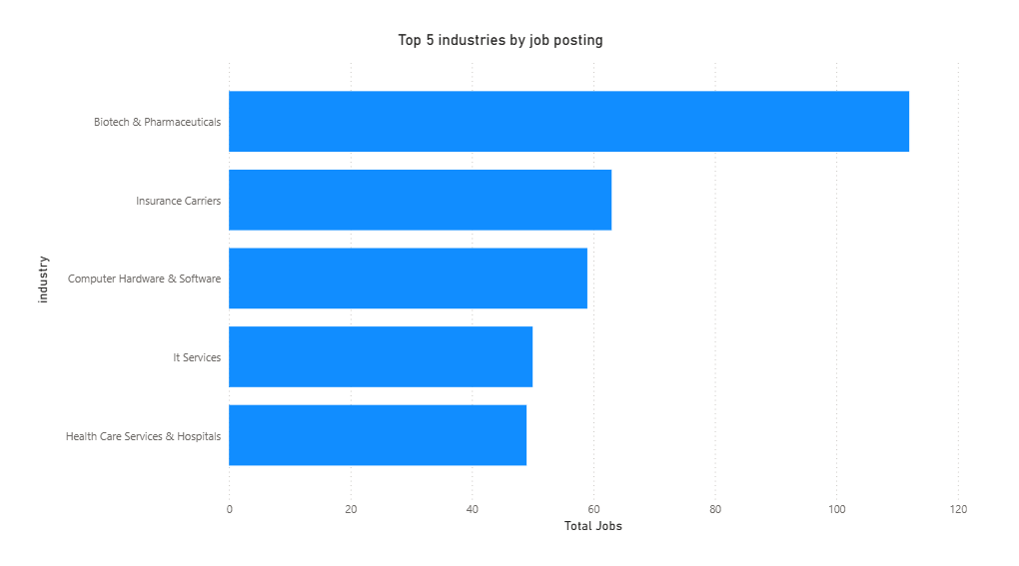
Industry Demand
The analysis identifies the top industries with the highest number of job postings. Industries such as technology and data-driven sectors dominate the job market, indicating a shift towards digital transformation and data-centric roles.
Key Points:
Technology sector leads in job postings
Growing demand for data-related roles
Reflects industry trends and innovation

Slide 16
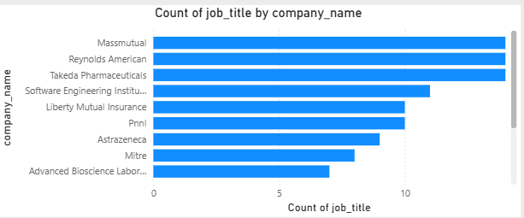
Total Jobs by Company Name
The analysis of total job postings by company highlights the organizations that are actively hiring in the job market. It reveals that a small group of companies contributes significantly to the total number of job openings.
Key Points:
A few companies dominate the majority of job openings
Large organizations tend to offer more opportunities
Helps job seekers focus on top hiring companies

Slide 17
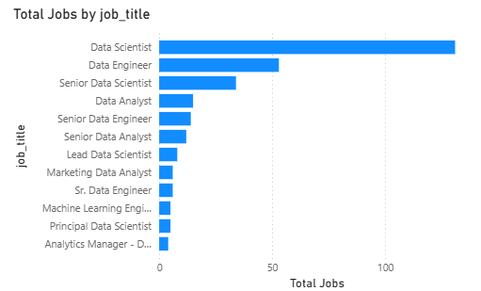
Job Titles with Most Number of Jobs
The analysis of job titles with the highest number of postings shows which roles are most in demand in the job market. Positions such as Data Scientist, Data Analyst, and Machine Learning Engineer appear most frequently, indicating a strong demand for data-related skills across industries.
Key Points:
Data-related roles dominate job postings
High demand for analytical and technical skills
Reflects growing importance of data-driven decisions
Helps identify popular career paths

Slide 18
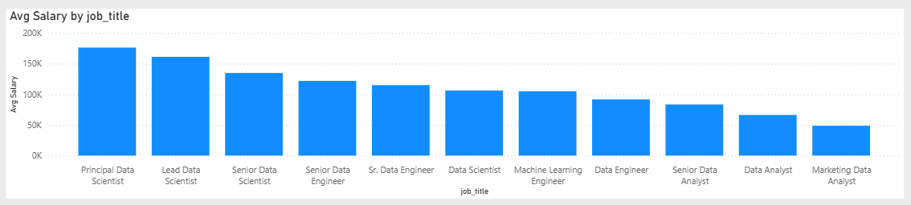
Salary of Job Titles with Most Number of Jobs
The salary analysis of the most common job titles shows how compensation varies across popular roles. While some roles have a high number of openings, their salaries may differ based on skill requirements and job complexity. Roles requiring advanced technical expertise tend to offer higher salaries.
Key Points:
Salaries vary across job roles
High-demand roles may not always have highest pay
Technical roles offer better compensation
Skill level influences salary differences

Slide 19
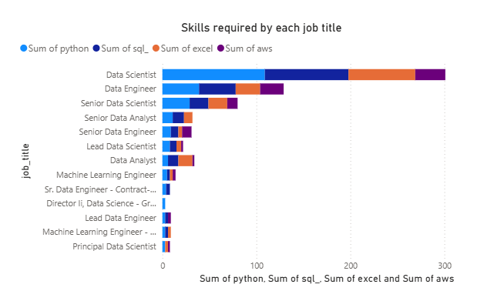
Skills Required by Companies
The skill analysis reveals that programming and analytical tools are highly valued in the job market. Skills such as Python, SQL, and Excel are fundamental requirements, while advanced tools like AWS and Spark are preferred for specialized roles.
Key Points:
Python and SQL are most in-demand
Cloud and big data tools gaining importance
Skills directly impact employability

Slide 20
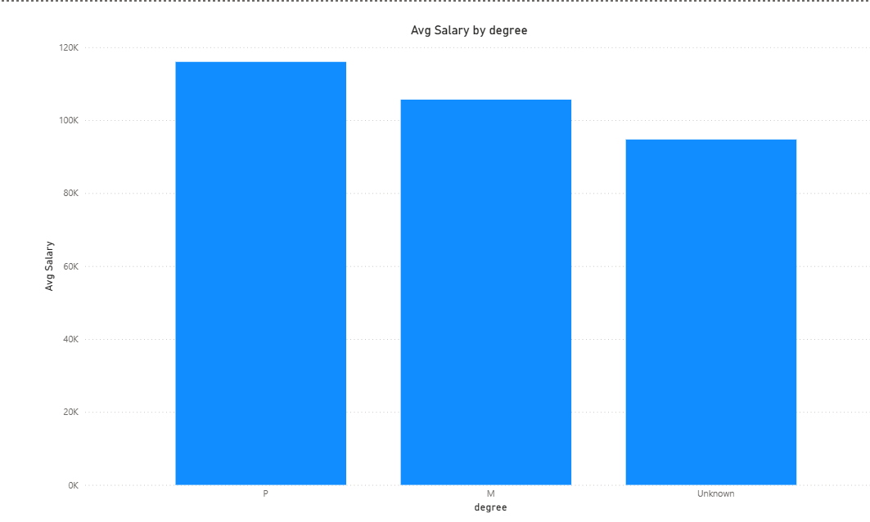
Education vs Salary
The relationship between education and salary shows that higher educational qualifications often lead to better compensation. However, practical skills and experience also play a crucial role in determining salary levels.
Key Points:
Higher education → higher salary
Skills and experience also important
Education adds value to career growth

Slide 21
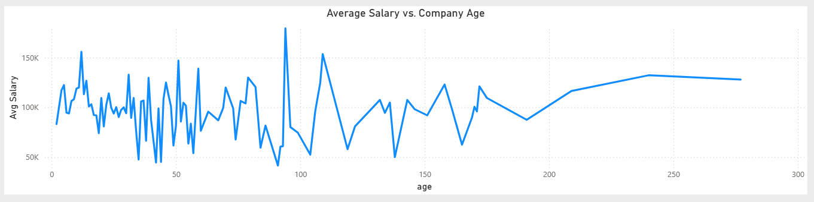
Average Salary vs Company Age
The relationship between average salary and company age shows how compensation varies with the maturity of organizations. Established companies often offer higher salaries due to financial stability and structured roles, while newer companies may offer competitive or variable pay based on growth potential.
Key Points:
Older companies tend to offer stable salaries
New companies may offer competitive or flexible pay
Company maturity influences compensation
Salary varies with growth and experience level

Slide 22
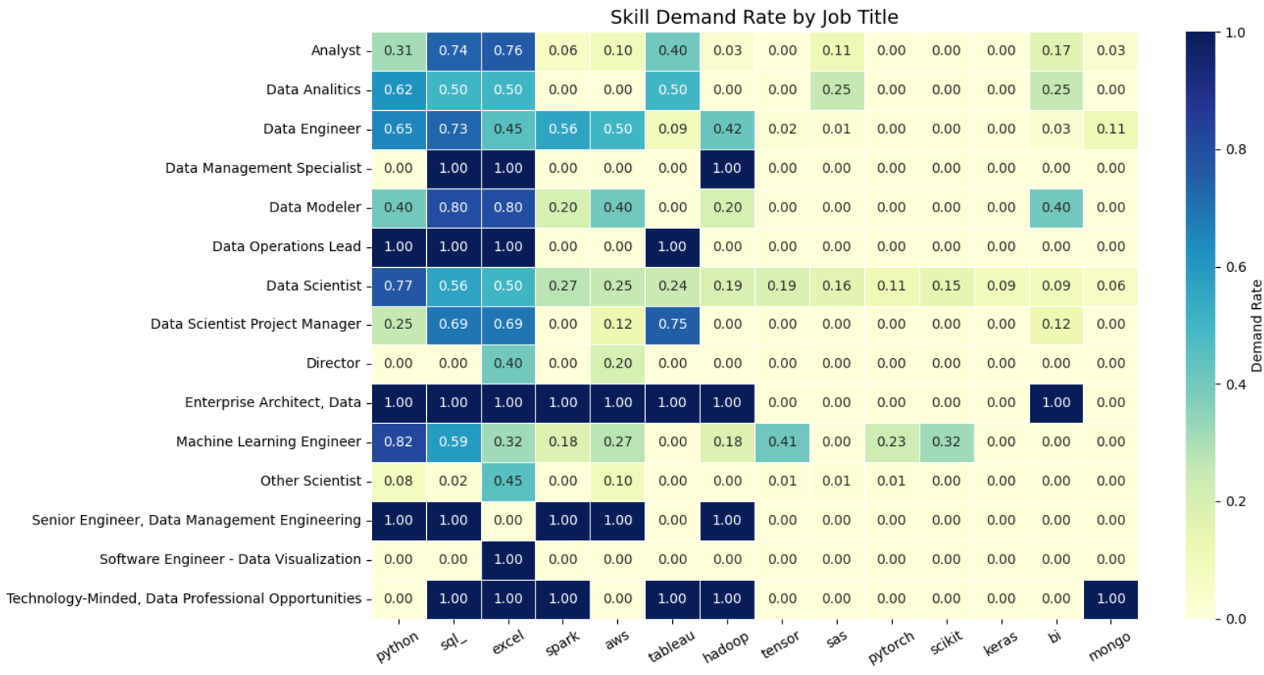
Skills Demand
Skill analysis highlights the most in-demand technical skills:
Python, SQL, and Excel are the most frequently required
Cloud and big data tools (AWS, Spark) are also significant
This reflects the industry's shift toward data-driven decision-making.

Slide 23
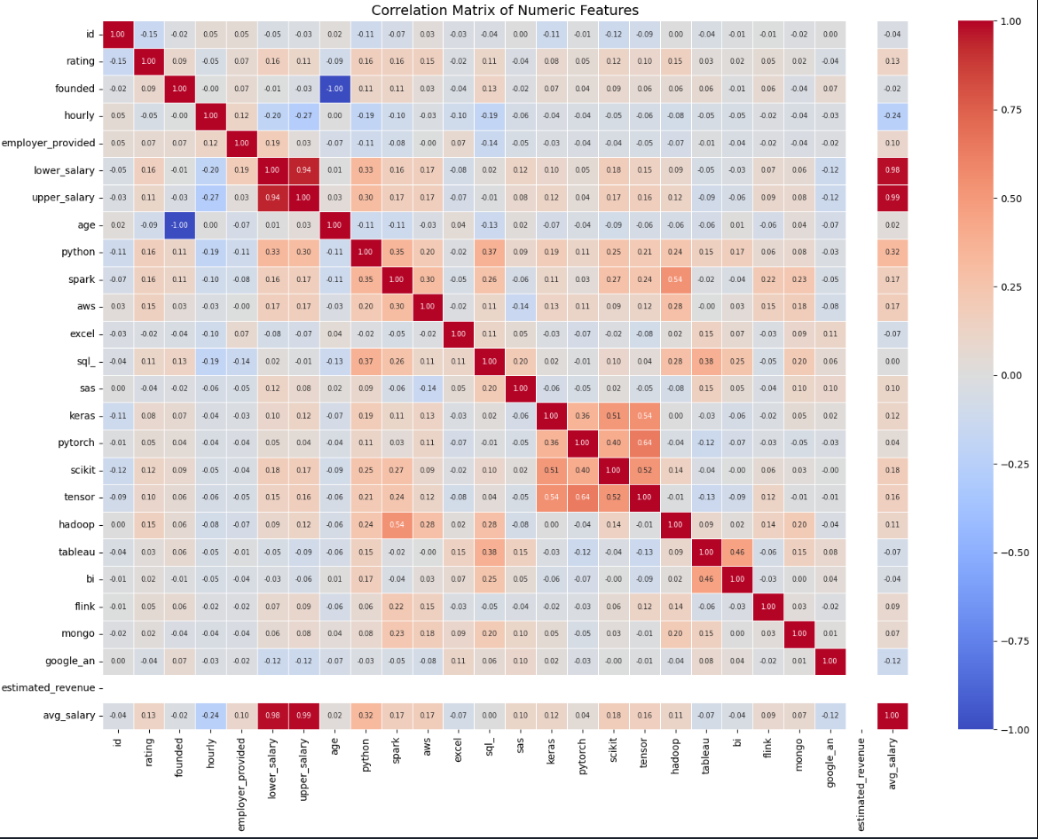
Correlation Analysis
Content: The correlation matrix highlights relationships between numerical variables such as salary, rating, and revenue.
This helps identify patterns and dependencies in the dataset.

Slide 24
Business Insights
Key takeaways from the analysis:
Skill-based hiring is increasing
Salaries vary significantly by location and role
Data-related roles are in high demand
Companies prefer candidates with multiple technical skills
These insights can help job seekers and organizations make better decisions.

Slide 25
Challenges Faced
Handling missing and inconsistent data
Cleaning unstructured text fields
Converting revenue and salary into usable formats
Ensuring accurate data transformation
These challenges were addressed through systematic preprocessing.

Slide 26
Conclusion & Future Scope
Conclusion: This project successfully transformed raw job data into actionable insights using Python and Power BI.
Future Scope:
Integration with real-time job data
Use of machine learning for prediction
Advanced dashboards with forecasting

